Slide 1
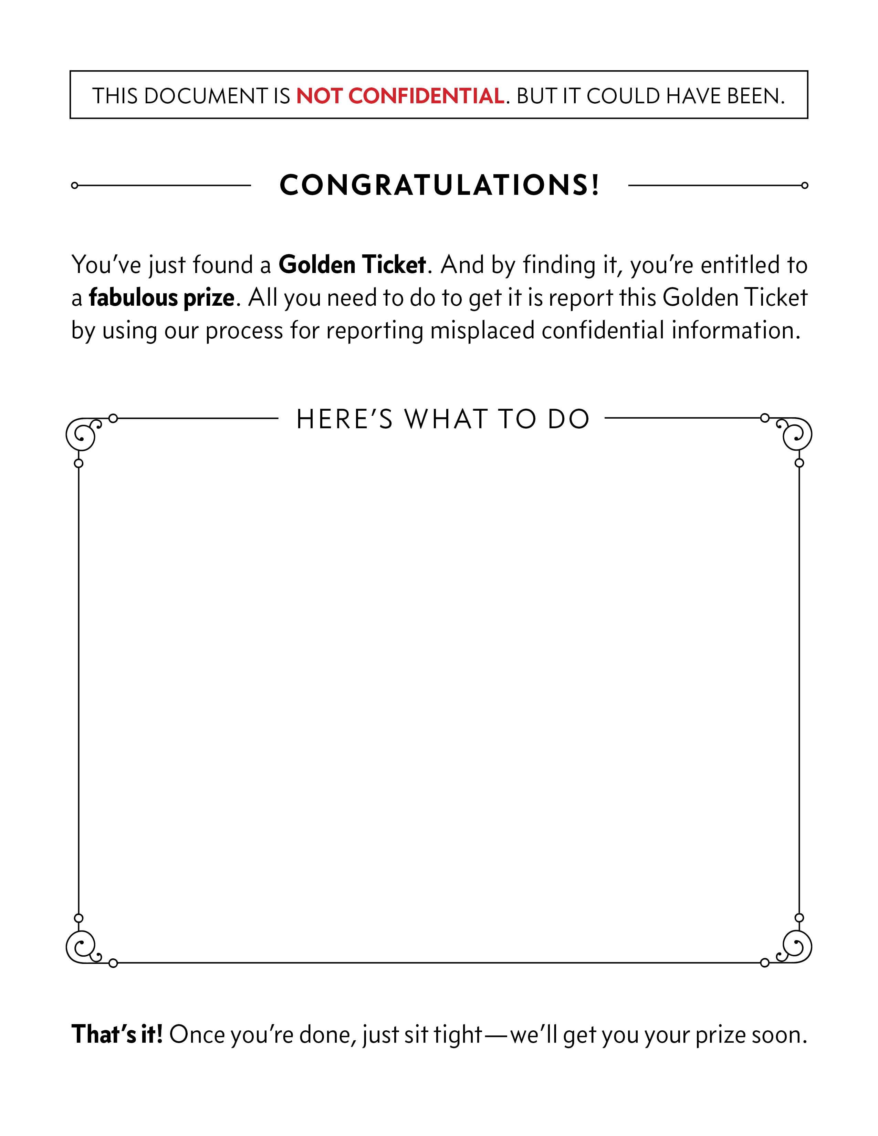
Click on this box to edit it, and type up your company’s process for handling unattended information.
For example, should employees:
Call the Ethics and Compliance Helpline?
Report it to their manager?
PDF a copy to a designated email inbox?
Whatever it is, make sure you include the same description in your email announcing the Golden Ticket activity in order to drive a consistent message.

